Slide 1
Prediction of bitcoin price
IA -530- PROBABILTY AND STATISTICS FOR ANALYTICS
Dr. Bebonchu Atems
Kavleen Kaur

Slide 2

Introduction to bitcoin :
Bitcoin commonly abbreviated as “BTC “ is a digital currency that was created on January 2008 by the mysterious and pseudonymous Satoshi Nakamoto.
It offers the promise of lower transaction than traditional online payment mechanism and unlike government-issued currency, it is operated by decentralized authorities.
Unlike a fiat currency, bitcoin system is a collection of computers also known as miners or nodes in case of bitcoins that runs the bitcoin’s code and store its blockchain.
A rapid appreciation in price and limited availability has converted Bitcoin into a store of value for investors.
Various initiatives have been launched in recent years to improve Bitcoin’s technology and to familiarize investors with its workings. For example, the Lightning Network seeks to make Bitcoin’s network faster and more efficient

Slide 3
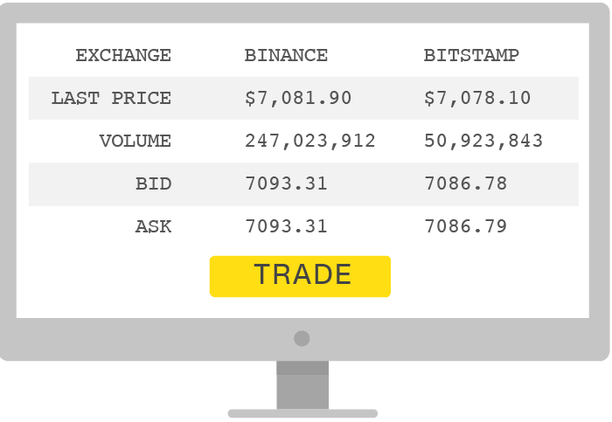


Understanding bitcoin :
Bitcoin can be used to buy merchandise anonymously. As it is not subjected by any regulations, it makes international payments easy and cheap. Small businesses may like them because there are no credit card fees. Some people just buy bitcoins as an investment, hoping that they’ll go up in value
Many marketplaces called “bitcoin exchanges” allow people to buy or sell bitcoins using different currencies. Coinbase is a leading exchange, along with Bitstamp.
People can send bitcoins to each other using mobile apps or their computers. It’s similar to sending cash digitally.
People compete to “mine” bitcoins using computers to solve complex math puzzles. This is how bitcoins are created. Currently, a winner is rewarded with 12.5 bitcoins roughly every 10 minutes.
Bitcoins are stored in a “digital wallet,” which exists either in the cloud or on a user’s computer. The wallet is a kind of virtual bank account that allows users to send or receive bitcoins, pay for goods or save their money.

Slide 4
Motivation for the predicting the price of bitcoin :
Bitcoin news is omnipresent. It was for real revolutionary for the financial markets. JPMorgan Chase & Co is the latest Wall Street firm floating the idea of investors using Bitcoin as a way to diversify their portfolios.
“In a multi-asset portfolio, investors can likely add up to 1% of their allocation to cryptocurrencies in order to achieve any efficiency gain in the overall risk-adjusted returns of the portfolio” -stategists.
Bitcoin has surged fivefold in the past year as prominent investors such as Paul Tudor Jones and Elon Musk have piled in, with Tesla Inc. recently announcing a $1.5 billion purchase of the asset. Bitcoin is outperforming stocks since the last five years.
Cryptocurrencies may be relatively new and volatile, but they’re also somewhat uncorrelated with other assets, and may be able to provide a good hedge. Former Federal Reserve economists Roberto Perli and Benson Durham at Cornerstone Macro LLC have run calculations and found that the volatility of equity portfolios can usually be reduced by adding some amount of digital assets.
One of the main reasons why gold has been popular among investors as a hedging instrument against inflation or uncertainty is the fact that gold is a scarce and limited resource, a characteristic shared by Bitcoin. There can only ever be 21 million Bitcoins, not a single one more, essentially making the digital currency a deflationary one, whose purchasing power, theoretically, increases every day
The Bitcoin price chart is still very volatile. On November 20th, 2015, Bitcoin (BTC) got indexed as other stocks. From the very first day constantly growing and was worth 327.00 USD. It reached its highest peak on December the 15th, 2017. The BTC value was 19’650.01. The market and even professional investors went crazy. On December 2018, the Bitcoin price chart dropped significantly. Many people lost 85% or even more of their capital invested in Bitcoins.. BTC was now worth a bit more than $3,000. On June 2019, the Bitcoin price chart raised up to another mountain peak. The renewed rise has surprised all skeptics. But at $11,865 the zenith was reached again. Since then, the Bitcoin price had leveled around $7 to $8k. The statistics predicted the value for bitcoin to rise in 2021 and that’s what motivated me to find out for myself.

Slide 5
Research papers on bitcoin price prediction:
Bitcoin Price Prediction by Ahmer Sabah and Mahpari Ansari- investigated the effect of p, q and d values on the achieved MSE in the prediction.
Bitcoin Price Prediction: An ARIMA approach by Amin Azari –ARIMA model results in larger MSE of the model due to price vulnerability.
Seq2Seq RNN and ARIMA models for cryptocurrency prediction: A comparative study by J. Rebane, I.Karlsson, Sdenic and P. papatetrou –RNN outperforms the ARIMA model.
Shukla S, Dev S(2020)- BITCOINS BEAT CORONAVIRUS BLUES.
Time series forecasting of Bitcoin using high-dimensional features: a machine learning approach by Mohammed Mudassir, Shada Bennbaia, Devin Unal and Mohammad Hammoudeh- machine learning model like ANN, LSTM, SVM, SANN outperforms the ARIMA model.

Slide 6
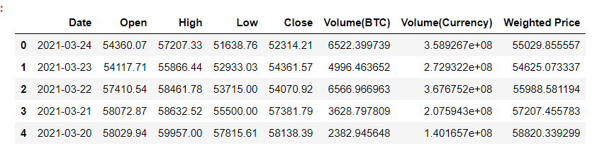
Data collection:
The best website that contains bitcoin data is coinmarket.com. It’s the most useful source for collecting data on not just Bitcoin but Either, Ripple etc. It is great source of information but we can get only small of data for free. For this reason, I fetched my dataset using an API of the website quadln.com, which is yet another excellent source for collecting data.
Before, the explanation of the data, I would like to explain how trading analysis is performed. There are four fundamental principles to be kept in mind:1) Price = direction of the trend, 2) Volume =strength of the trend 3) Price and volume together confirms the market direction 4) Divergence leads to market weakness. Thus, volume and price of the market determine whether the market is witnessing a bullish character- rise in the market ( Price and volume are moving in the same directions) or bearish character (price and volume are moving in differently directions). Now, in order to determine the future price of bitcoin, we needed to collect data from previous years. We also needed to predict the volume to determine correct the market trend.
The data collected thus mainly encapsulates the closing price, opening price, volume of BTC collected daily from October of 2011 to March of 2021.

Slide 7
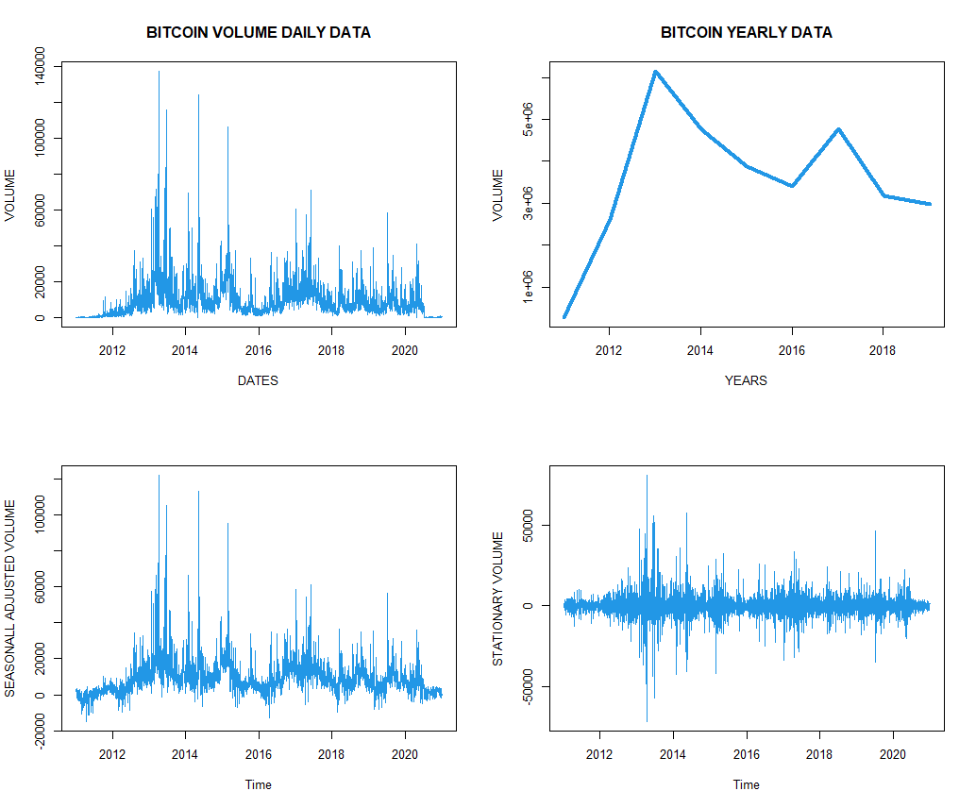
Stationarity and seasonality:VOLUME

Slide 8
Making volume stationary:
In order to make the volume stationary, we had to take log first differencing in order to make the VOLUME_BTC variable stationary.
Earlier, while performing tests, we saw that the kpss stationarity test stated as the variable non-stationary but now it deems the variable stationary.
In next slide, similar analysis is performed for the closing price of the variable.
After making the variables stationary and also making them seasonally adjudsted, we can fit these variables to a model (in this case ARIMA model) and then try to forecast the price and the volume of the data

Slide 9
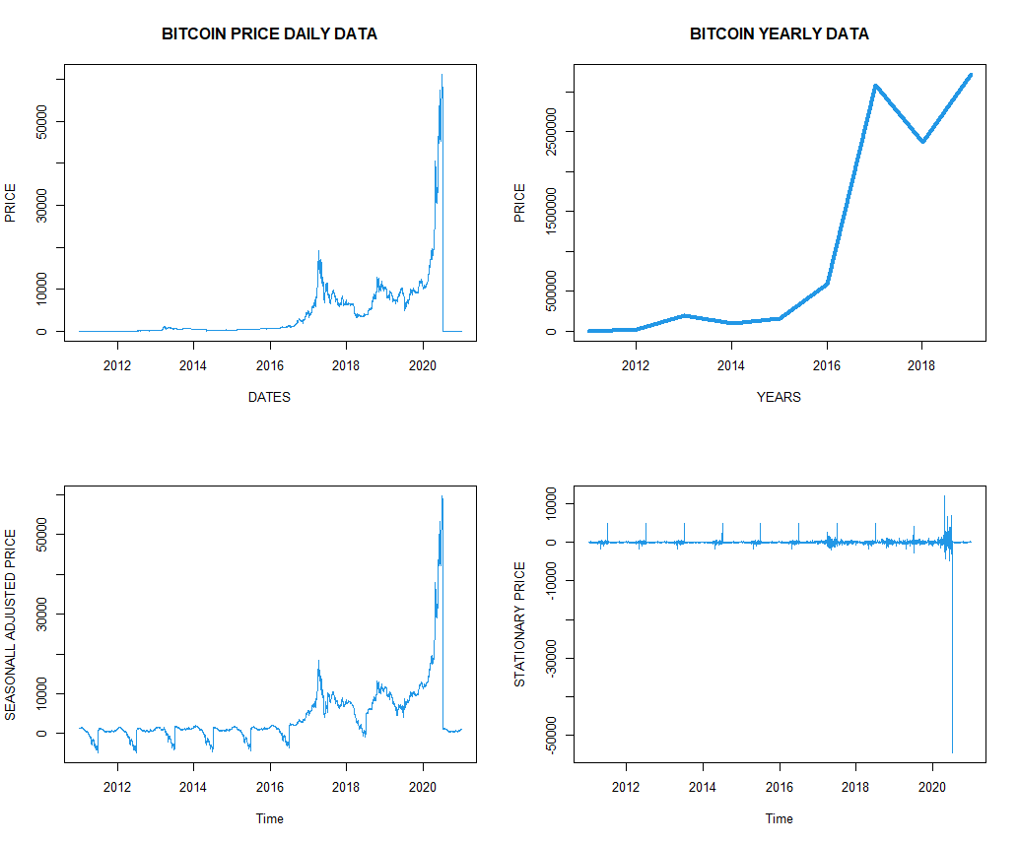
Making close variable stationary
TEST RESULTS BEFORE DIFFERENCING
TEST RESULTS AFTER LOG FIRST DIFFERENCING

Slide 10
APPLYING ARIMA MODEL
ARIMA, short for ‘Auto Regressive Integrated Moving Average’ is actually a type of model that ‘explains’ a given time series based on its own past values, that is, its own lags and the lagged forecast errors, so that equation can be used to forecast future values.
An ARIMA model is characterized by 3 terms: p, d, q
where,
p is the order of the AR term
d is the number of differencing required to make the time series stationary
q is the order of the MA term
To be precise ‘p’ is the order of the ‘Auto Regressive’ (AR) term. It refers to the number of lags that should be used as predictors. And ‘q’ is the order of the ‘Moving Average’ (MA) term. It refers to the number of lagged forecast errors that should go into the ARIMA Model.
After putting p, q, d values into the ARIMA mode, we can find the model that best fits the data by finding the minimum AIC VALUE.
In this particular case, the model that best fits the data is ARIMA(13,3,2). This model has the least AIC values among the rest. In this particular case, lags used as predictors i.e. p which is the order of AR term is 13 and the order of Moving Average is 2
Now, we will fit the data to the model and then use it to forecast daily values for the next whole year.

Slide 11
DIFFERENT ARIMA MODEL :
AS WE CAN CLEARLY THAT THE ARIMA(13,3,2) HAS THE LEAST AIC VALUE SO IT CLEARLY FITS THE DATA THE BEST.

Slide 12
FORECASTING USING PROPHET
Prophet is a procedure for forecasting time series data based on an additive model. It works best with time series that have strong seasonal effects and several seasons of historical data. Prophet is robust to missing data and shifts in the trend, and typically handles outliers well.
Prophet detects the following trend and seasonality from the data first, then combine them together to get the forecasted values so, in case of prophet we do not necessarily need to seasonalize the data first.
Prophet requires a fixed format of the data frame. The format that Prophet expects to see is that there needs to be a ‘ds’ column that contains the datetime field (in our case date) and a ‘y’ column that contains the value we are wanting to model/forecast.( closing price and volume of the bitcoin).
It is fairly easy to use prophet to forecast any variable and is also not time consuming.

Slide 13
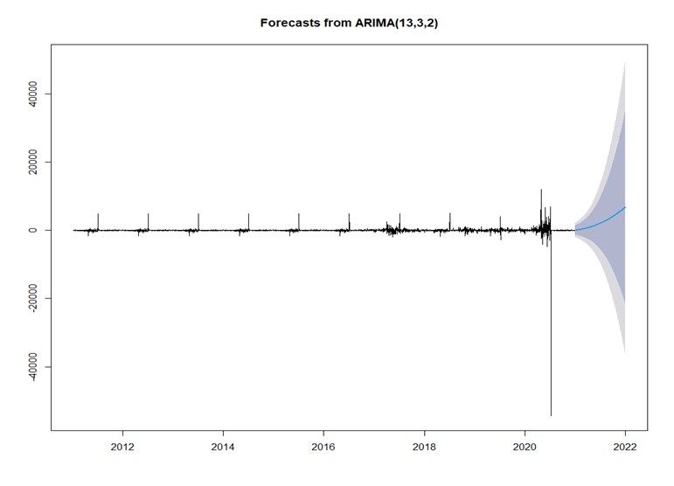
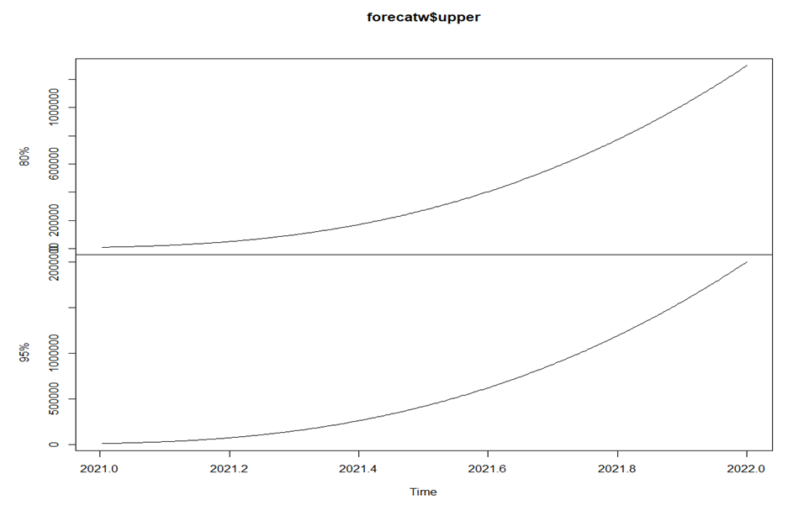
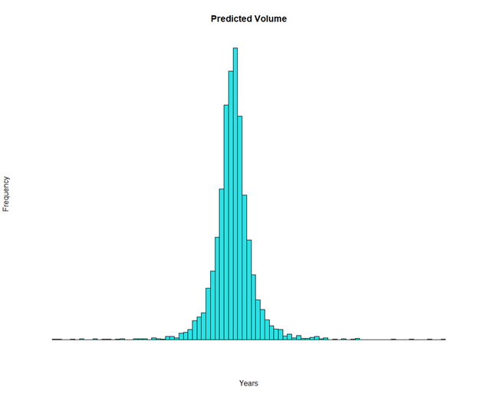
Predictions from arima model

Slide 14
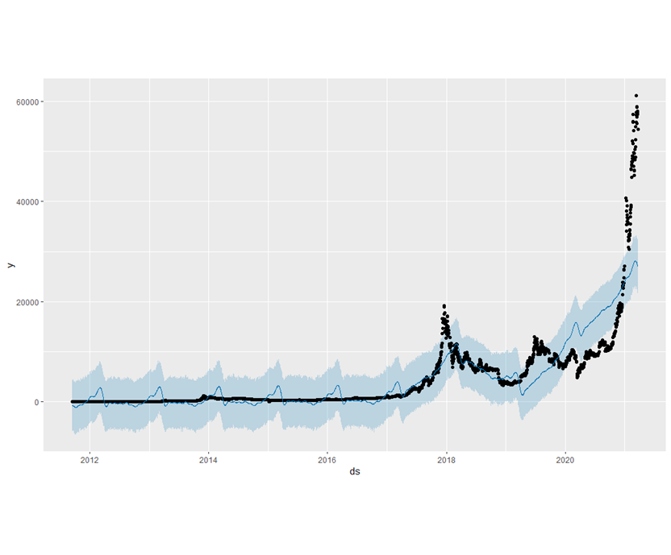
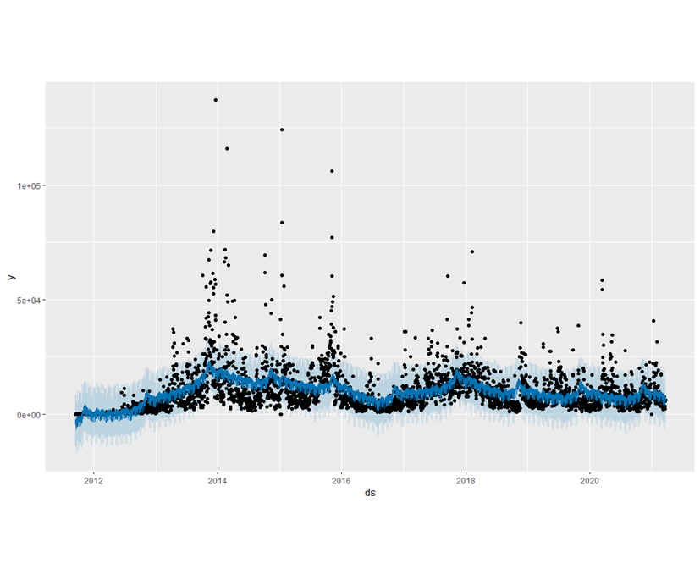
Prediction with prophet

Slide 15
scope of Future research :
The most accurate bitcoin price predictors is the stock to flow model created by Twitter. This model is based off bitcoin scarcity and the halving events of bitcoin. The model has fairly-accurately tracked the bitcoin in the past. The halving event will continue taking place until the reward for miners reaches zero. Thirty-three halving events every four years equal to 132 years total. The last bitcoin would be mined in 2140.
The stock to flow is a number that shows how many years at the current production rate are required to achieve the current stock. The higher the number, the higher the price so the stock to flow model based on scarcity and the production rate of new bitcoin.
Apart from this, models like RNN, LSTM mainly machine learning or deep learning models could do better.
We can try to find better ARIMA models.

Slide 16
Question and answer session

